Slide 1
ANALYSIS OF COUNTRY’S BEST’S EXPANSION
Team WE (Yiwei Liao, Chenglai Huang, Jieyi Wang, Janice Li, Xiao Jiang)

Slide 2
CURRENT FINANCIAL SITUATION
Profitability, Liquidity, Efficiency and Debt

Slide 3
Financial Analysis
Financial Analysis of Country’s Best in 2016
Ratio |  | Result | Trend | Industry benchmark
Profitability | Gross profit margin | 22.7% | ↑ | 15.3%
 | Net profit margin | 3.2% | ↑ | 2.5%
Liquidity | Current ratio | 0.8 | - | 1.7
Efficiency | Stock turnover | 26.9 | ↓ | 41.8
Debt | Debt/Equity ratio | 1.7 | ↓ | 2.3
Total revenue ↓ 9.2 %
Operating expense ↑ 23% ≈ 15% of total revenue

Slide 4
SUMMARY
Increase sales revenue
Reduce operating expense
Improve liquidity
Improve stock efficiency

Slide 5
IMPROVE FINANCIAL STATUS

Slide 6
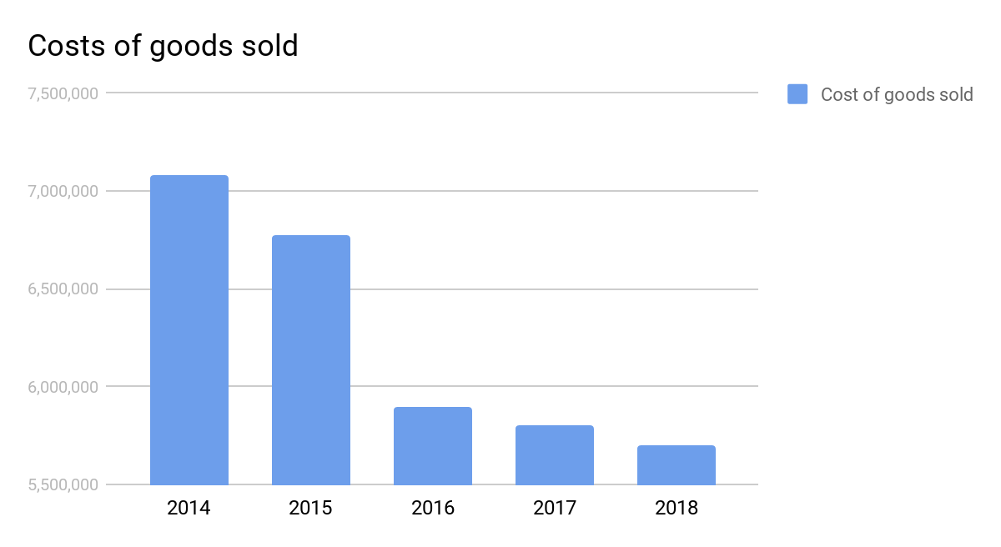
1. Decrease the costs of goods sold by negotiating with suppliers
Our token:
1. Our expansion plan.
2. The advertising benefits brought by our brand effect.
Our goal:
1. Get long-term supply agreement in a lower price.
2.Reach the gross profit margin of 25%.

Slide 7
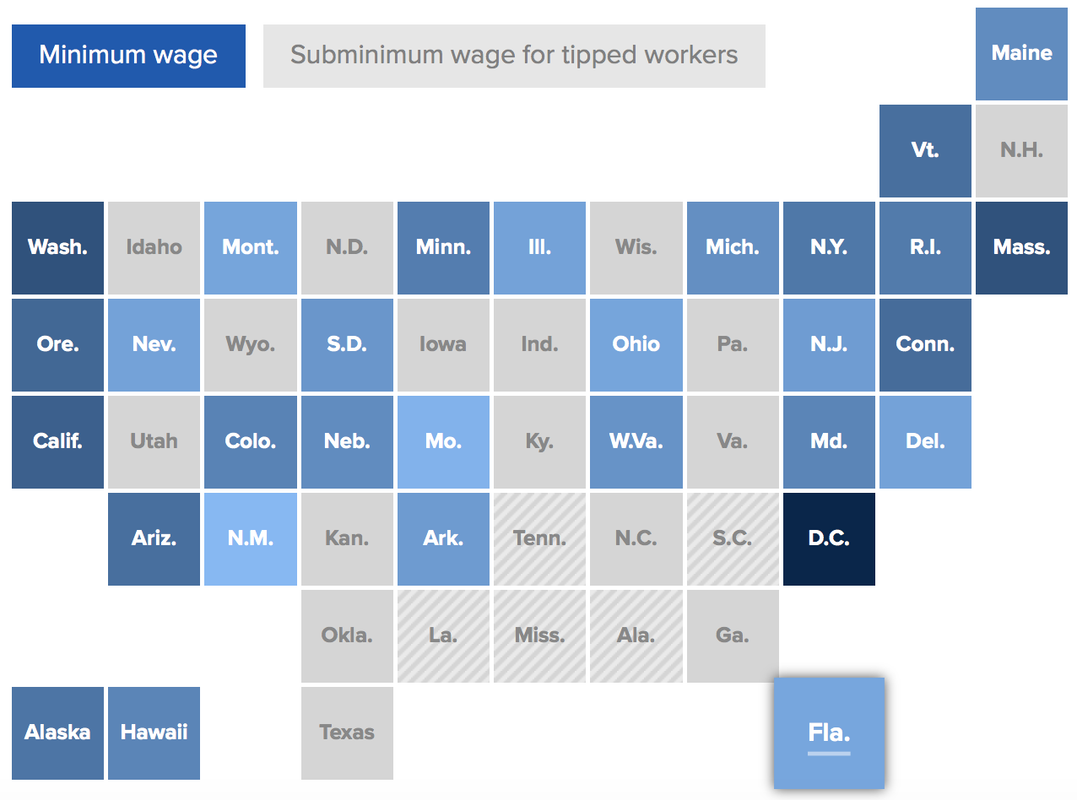
2. Gift card option to lower labor cost
3 out of 10 states covered by our stores raise minimum wage in 2017

Slide 8
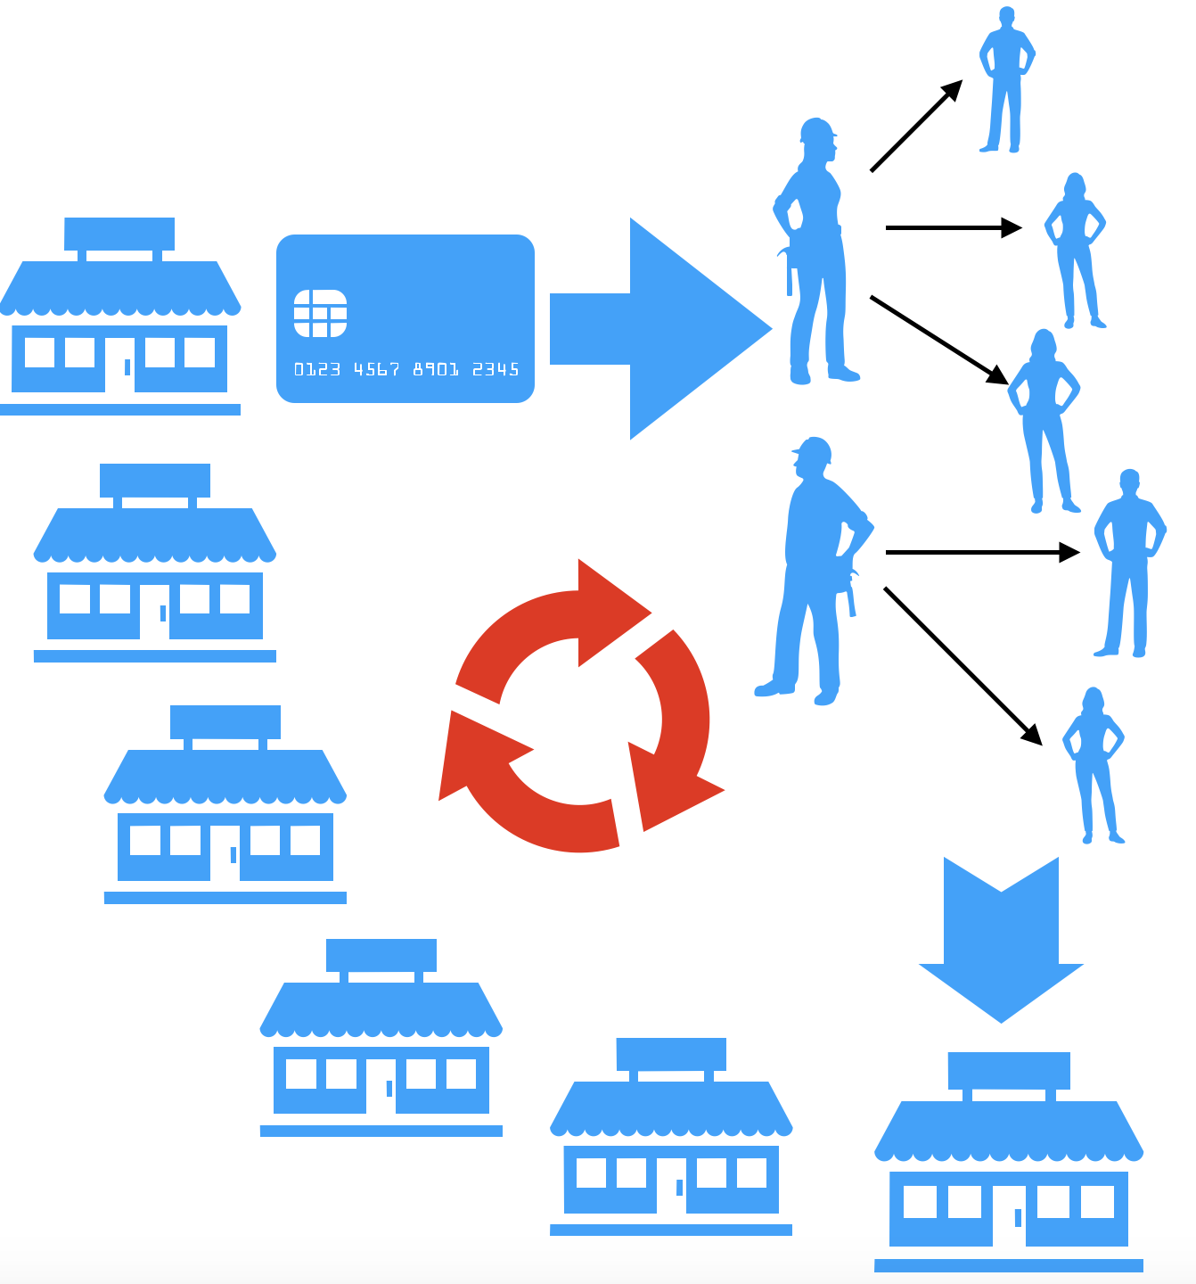
2. Gift card strategy
As employees’ bonus
As a small part of salary (optional) (e.g. 15$/h*12h=180$=160$ in cash +25$ in gift card)
Short term
Save cash and reduce labor cost
Construct a closed loop for gift card
Stimulate sales
Reach more underlying customers
Long
term

Slide 9
3.Incentive Stock Option & Attract More Investment
For employees | For investors
Incentive Stock Option | Attract more investment
Sell stock for more cash Increase employees’ motivation and sense of belonging | Our fast-growing earnings per share (24% annual growth) attract investors
Notes:
Confusing. internal changes vs external changes

Slide 10
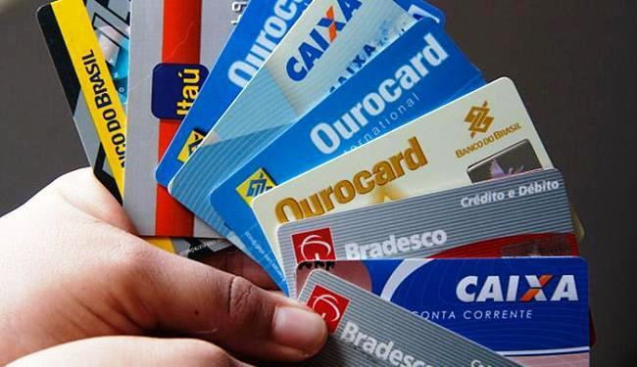
4. Build our own store credit card
An entice to customers to consume more
Customers owning amazon credit card spend 16 % more than Amazon Prime members
2. Chance to negotiate for a lower credit card processing fee
3. Keep a close tie with customers that informs them of our events
Notes:
combine 3 graphs into one to show changes? not so scattered

Slide 11
5. Cut down credit card expense
Not convenient and friendly
Young people are going cashless
Our feature:
Low marginal profit
Small average ticket size
…….
A minimum credit card purchase
Encourage customers to use more cash or our store credit card;
E.g. Hold monthly contest for gift card to reward people
Thus the credit card expense is heavy
Using positive way to build relationships and educate customers on the cost of credit card

Slide 12
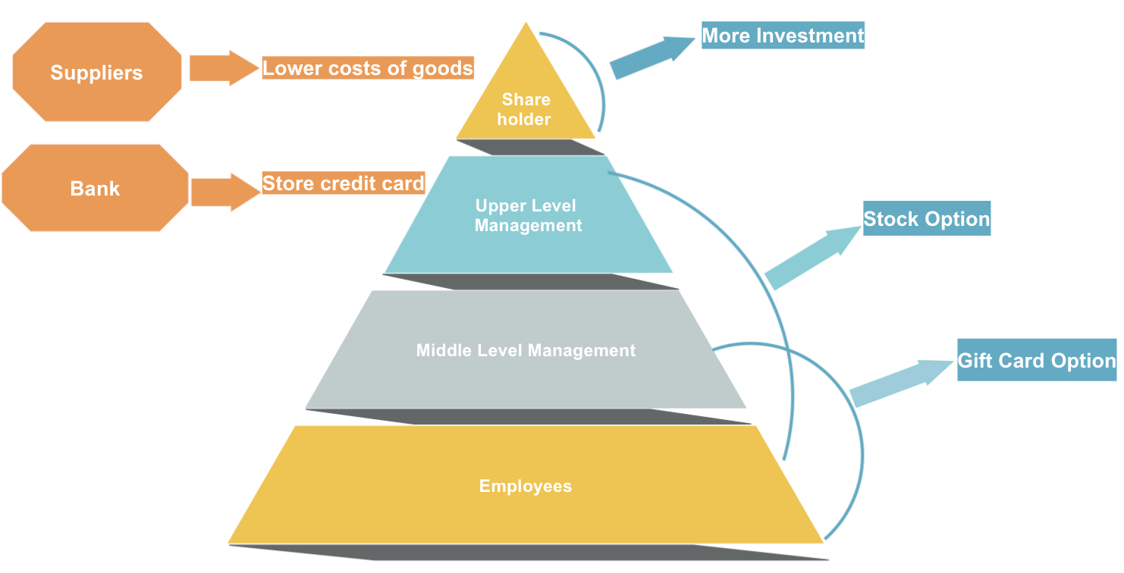

Slide 13
IS AUTOMATION
OUR CHOICE?
Finance, Customer Experience, Efficiency, Brand image

Slide 14
Is Automation our choice?
Save salary expense
Reduce queuing time
Eliminate human errors
Increase credit card fee
Technical difficulty
Minimize communication
Increase thefts
Harm the brand image
Partial Automation
Pros
Cons

Slide 15


Automation Tier Comparison
Tier I (Densely populated areas)
High market wage
More customers queuing
More job opportunities for laid off employees
Tier II & III (Suburban areas)
Interactions and emotional bonds with customers
Need to strengthen engagement with local communities
Notes:
definition of tier 1/2/3: more dense populated area for tier 1 compared to 3

Slide 16
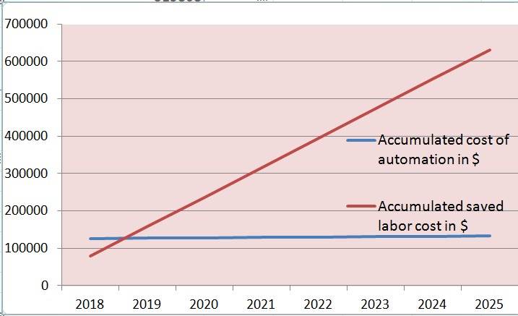
Estimated Result of Partial Automation
Initial Investment
$130k / store, including fees for changing interior design of stores
Saved variable costs
6 * 12 * 52 + 2 * 25k - 1k
= $78,952 / year * store
Notes:
graph of the intersection point (1-2 years) between investment and saving

Slide 17
A NEW ERA OF C-STORES...
Notes:
However, influenced by multiple trends in the market such as shopping diversification and change of consumer habits, focusing on the store itself is not sufficient anymore. In order to expand at a rapid rate, we aim to transform our shopping experience into an enjoyable and essential part of our customers’ lives. So allow me introduce to you our vision of Country’s Best and the C+ concept.

Slide 18
The C+ Model (Convenience+)
Convenience
C+
Community
Care
Commerce
Notes:
The C+ Model is the ultimate driver of success in the new retail era. It consists of 4 important parts: Convenience, Care, Commerce and Community. Our goal is to further differentiate ourselves from large-scale, all-around retailers such as Whole Foods and find a new place in the market by staying closer to the customers and their daily lives. Now my teammate and I will demonstrate to you some of the key components of C+ in practice.

Slide 19
From Shopping to a Lifestyle
Buy some snacks & drinks
Grab some desserts & food
Enjoy a wonderful afternoon
in our market section
in our interactive section
with Country’s Best Family and neighbors

Slide 20
Loneliness As a Modern Epidemic
Slower Pace of Life
¼ respondents have no one to talk about personal issues
More than ½ if family members are not counted
--McPhearson, Smith-Lovin, and Brashears
Time and willingness to enjoy such lifestyle

Slide 21
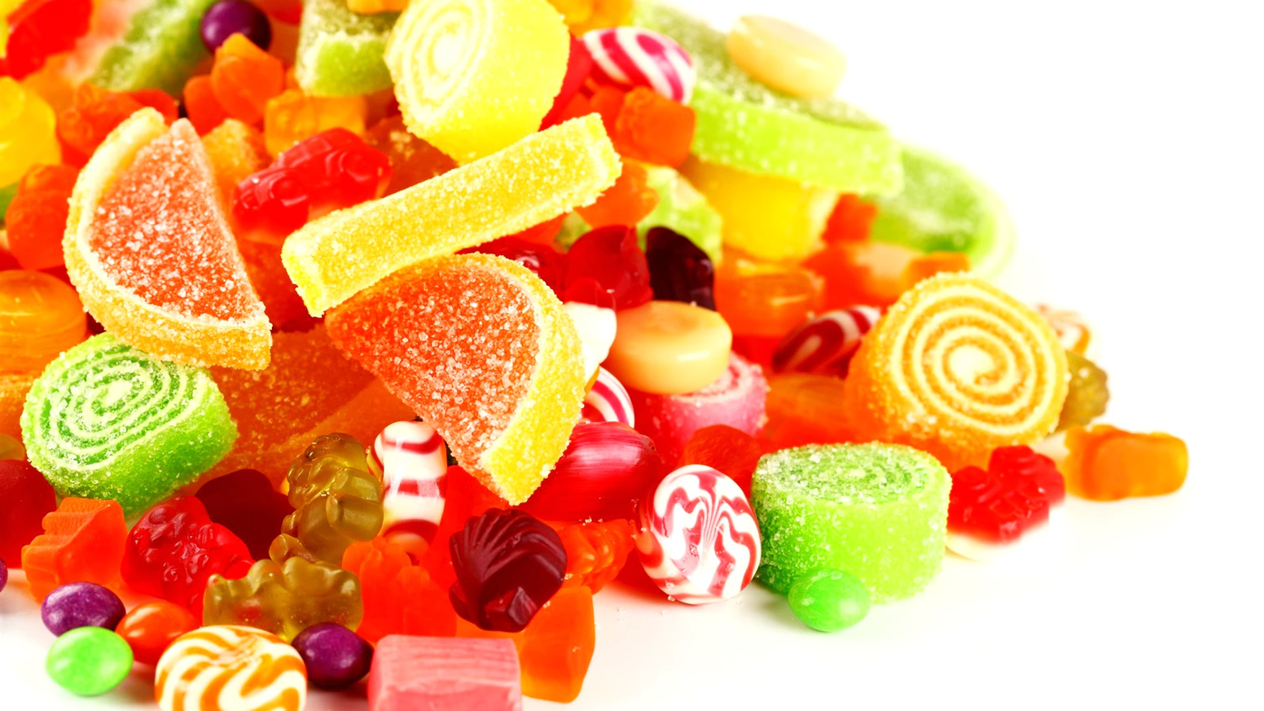
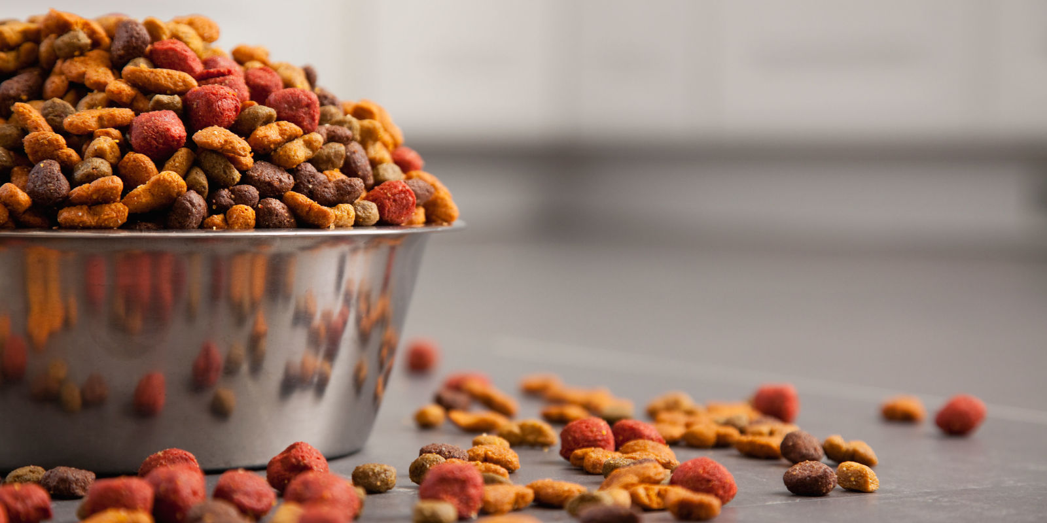
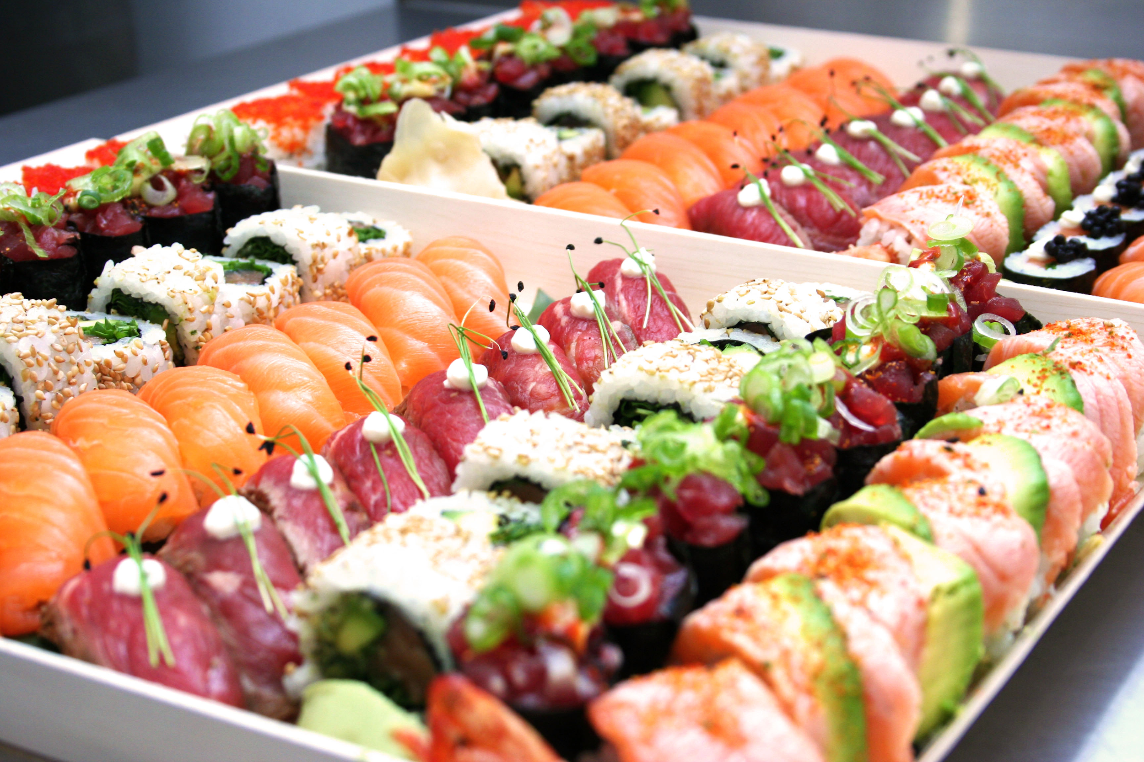
2. Themed Shopping Events
CARE for CUSTOMERS
SURPRISE & FRESHNESS
LOYALTY → SALES
Periodic shopping events of various themes
Targeting at different groups in the community

Slide 22
Product Line Optimization
Trend： Consumers shop at multiple stores.
Focusing on our reputation as a “friendly neighbor”, we aim to forgo the one-store-fits all prototype and transform our shopping experience into a part of our customers’ unique lifestyle.
What Does the Community Want?
Notes:
Because of the rise of eCommerce and various ramifications of traditional retail, consumers will not buy all of the things in one store anymore. As a result, convenience stores need to more targeted service and appeal more to the customers’ essential lifestyles. As a company who operate on its “friendly neighbor” reputation, the important question we need to ask ourselves is “What does the Community Want?”So instead of providing an all-around SKU combination ranging from beauty aids to automotive parts, we aim to adjust our product line to provide only the most demanded and fast-flowing goods such as beverages, band-aids and condoms.

Slide 23
Product Line Optimization
Lifestyle
Fast-Flowing/
High-Margin
Food(FF)
Beverage(FF)
Condoms & Lubes(FF & HM)
Stationary(FF)
Chargers(HM)
Cosmetics
Automotive Parts
Clothing
Books
Essential
Notes:
This means that we will reduce the sales of beauty aids and automotive parts, thus closing the gap between our store and customers’ everyday lives. Here the keyword is lifestyle, you can see some of the things we will focus on in the future and some of the things we will discourage. This concept also echoes with large c-store chains in East Asia too where companies like Family-Mart and Lawson are all making changes like this.

Slide 24
Over 3000 SKUs
2000 SKUs
Replacing 500-800 SKUs Annually
Big Data
Notes:
Our final goal is to trim our current product line from over 3000 SKUs down to about 2500, cutting away products that are sluggish or incompatible to our core value (lifestyle). At the same time, As we closely monitor the change in customer’s preferences, we recommend replacing 1000-1500 SKUs annually to continuously stay on the top of the trends. With this and the application of Big Data we can also decrease our inventory level to save more cash at the end of the year.

Slide 25
Community Involvement
Cater:
Parties
Conferences
Graduation Ceremony
Sponsor:
School Events
Charity Events
Local Sports Competition
Product
Service
Notes:
Outreach , more visible

Slide 26
EXPANSION METHODS
Business conversion program (BCP) franchising
+
Company-owned operations

Slide 27
Business conversion program (BCP) franchising
The conversion of independent dealers or unaffiliated businesses to franchisees
Low capital investment：
training fee($4000)<franchise fee($500,000)
Fast rate of expansion:
expertise of an established businessperson
Existing communal bonds:
strengthen friendly neighbor concept
Undermine core values:
conversion franchisees place profit before reputation
Major changes implementation: managers are resistant to changes

Slide 28
Company-owned operations
20%
Total cost of $16,500k for setting up 55 stores per year
Notes:
110+140=250 64%
140 36%

Slide 29
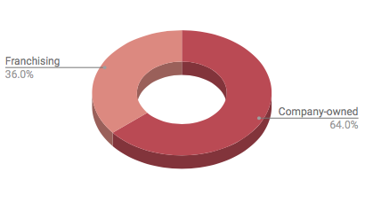
Expansion plan
First 2 years:
Purely company-owned operations
Following 5 years:
50% company-owned and 50% franchising

Slide 30
Reference page
https://www.netleaseadvisor.com/tenant/7-eleven/
http://www.franchisedirect.com/retailfranchises/7-eleven-franchise-07012/ufoc/
http://www.cspdailynews.com/category-news/general-merchandise/articles/winsight-s-2017-convenience-retailing-trends#page=4
http://www.sohu.com/a/139885025_726993
http://web.mit.edu/2.744/www/Project/Assignments/humanUse/lynette/2-About%20the%20machine.html
https://www.forbes.com/sites/greatspeculations/2017/01/18/why-amazon-has-launched-a-new-credit-card-for-prime-users/#8f0a2235f5ba
https://www.amazon.com/bulk-gift-cards/b?ie=UTF8&node=15243200011

Slide 31
Thank you!

